Slide 1

ON-DEVICE KWS AND SPEAKER RECOGNITION SYSTEM FOR DISCREET EMERGENCY ASSISTANCE ON ANDROID
DIANA LAURA FERNÁNDEZ DUARTE
National Institute of Telecommunications – INATEL
TP557

Slide 2
ABSTRACT
This paper presents an Android-compatible system for discreet emergency assistance, specifically targeting victims of domestic violence. We propose a hierarchical Convolutional Neural Network (CNN) architecture combining Keyword Spotting (KWS) and Speaker Recognition (SR) to minimize false alarms. The KWS module detects innocuous Portuguese keywords, "Morango" (strawberry) and "Pipoca" (popcorn), in 1-second audio clips, while the Speaker Verification module confirms the victim's identity (enrolled as "Diana"). Models were trained using MFCC spectrograms (40 Mel filters, 13 coefficients per window) and optimized via hyperparameter tuning. Implemented on-device through a web application, the system achieves more than 98% accuracy on test sets (KWS: 98.31% accuracy, SR: 98.84% accuracy) with low loss (<0.038). Developed using Edge Impulse, this solution demonstrates robust real-time capability on mobile devices, offering a privacy-preserving alternative for emergency intervention. The system's source code is publicly available.

Slide 3





INTRODUCTION
According to a UN report from November 2024, around 736 million women have experienced physical or sexual violence from their partners.
In Brazil, in 2022, 34.5% of all femicides happened in the victims' own homes.
It is crucial to develop systems that enable victims to seek help quickly and discreetly.
KWS technologies detect specific words or phrases in audio without needing to touch the device.
Speaker Recognition (SR) allows the identification of the speaker based on their biometric voice characteristics.

Slide 4
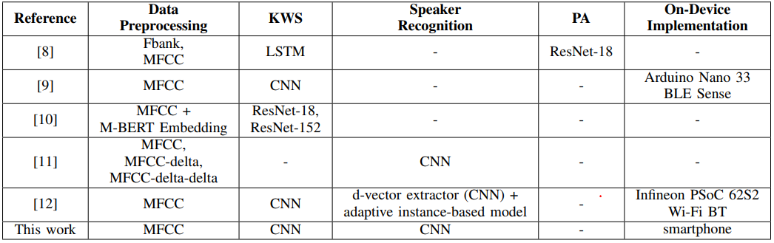
RELATED WORK
TABLE 1: Work related to KWS and SR.

Slide 5
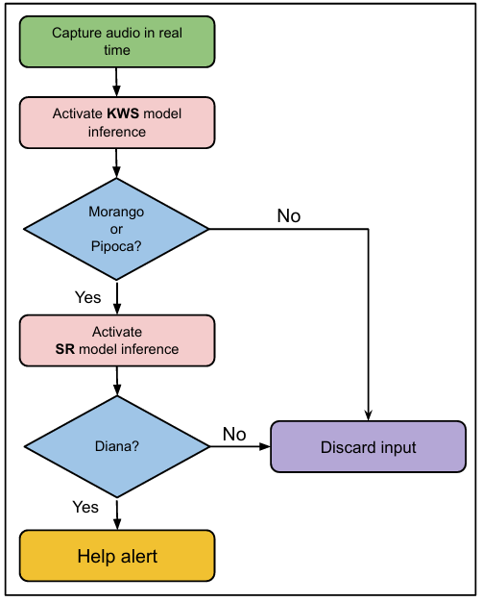
CONTRIBUTIONS
Fig. 1: System Flow Diagram.

Slide 6
DATA COLLECTION
The samples were organized into different classes according to the specific objectives of each model.
For the KWS module, 1630 samples were collected for each of the following classes: Morango, Pipoca, and Noise, totaling 4890 samples.
For the SR module, 2160 samples were collected for each of the following classes: Diana and Other, totaling 4320 samples.
60% of all samples were used for the training set, 20% for the validation set, and the remaining 20% for the test set.
All samples have a duration of 1 second and a sampling rate of 16 kHz.

Slide 7
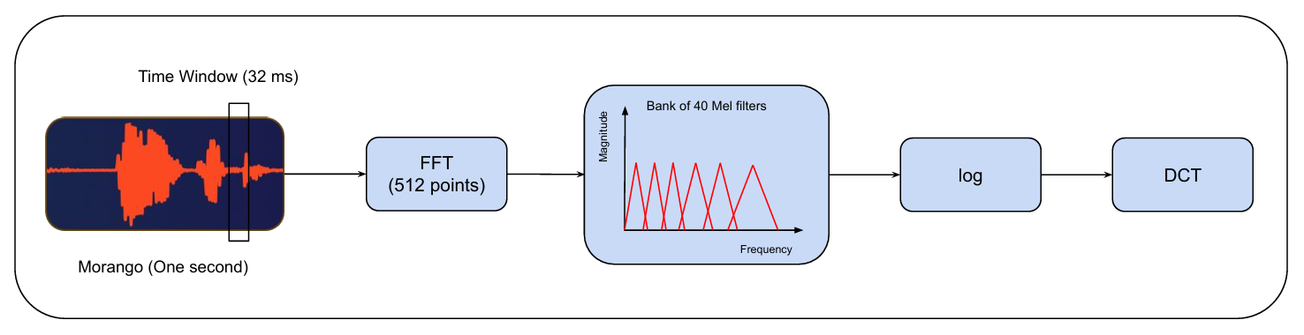

MEL-FREQUENCY CEPSTRAL COEFFICIENT (MFCC)
FFT
(512 points)
Bank of 40 Mel filters
Morango (One second)
Amplitude
Log()
DCT
Time window
(32 ms)
Frequency
Fig. 2: Block Diagram of MFCC.

Slide 8
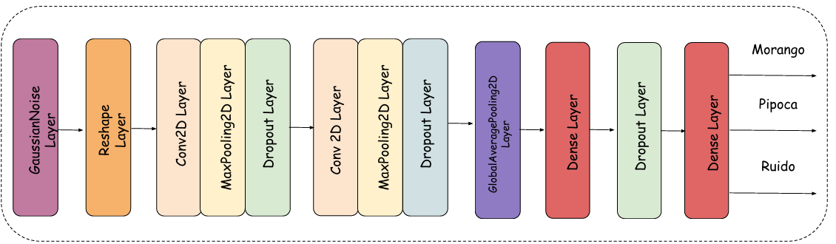
KWS MODULE
MFCC
Noise
Fig. 3: KWS model architecture
Training
Maximum 100 training epochs
Early Stopping (Patience=15)
SpecAugment
Adam Optimizer
Learning Rate = 0.0007
LearningRateScheduler

Slide 9
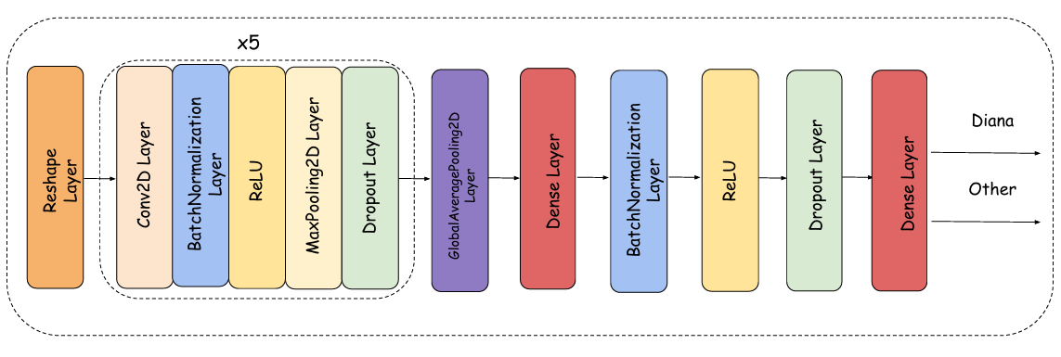
SR MODULE
MFCC
Fig. 4: SR model architecture
Training
SpecAugment
Early Stopping (Patience=15)
Adam Optimizer
Learning Step = 0.0007

Slide 10
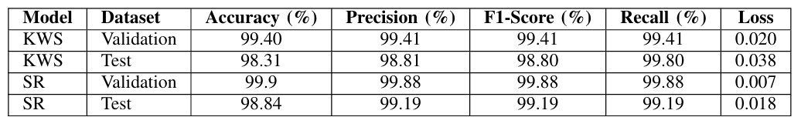
RESULTS
TABLE 2: Performance of the Models

Slide 11
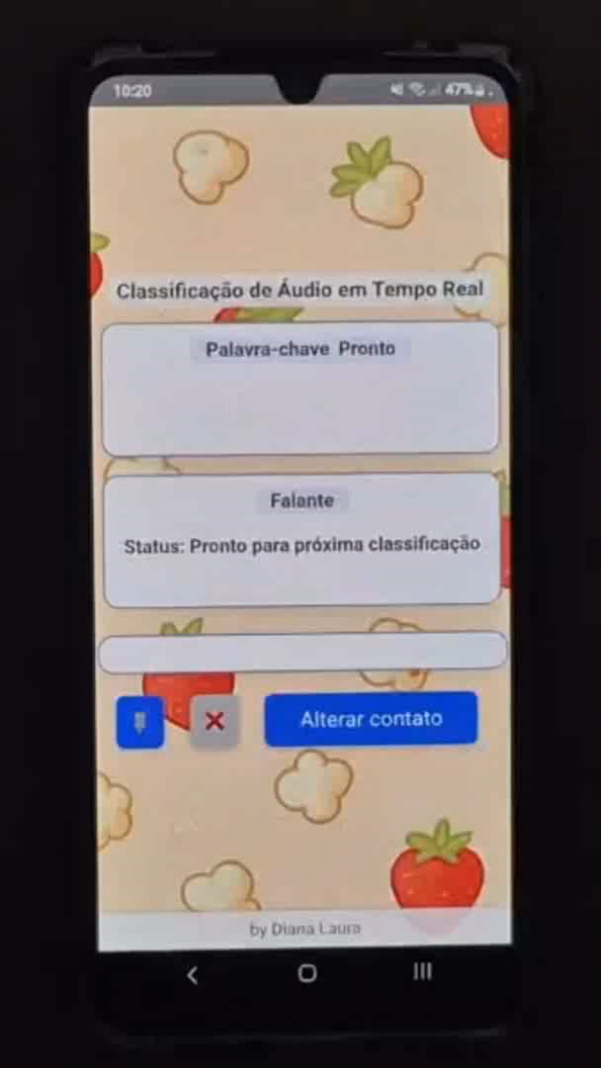
ON-DEVICE IMPLEMENTATION
Fig. 5: Android application interface

Slide 12
CONCLUSIONS
This work presents a high-accuracy (> 98%) and privacy-focused emergency system for Android that empowers domestic violence victims through discreet voice-activated alerts.
Implemented via Edge Impulse with real-time capability, it offers a scalable, privacy-preserving alternative for urgent assistance.
Future work will expand speaker and keyword diversity and integrate emotion recognition.
The system’s open-source availability and low-resource deployment potential highlight its life-saving applicability in critical scenarios.

Slide 13
REFERENCES
[1] UN Women, “Facts and figures: Ending vi-olence against women,” November 2024. [On-line].
[2] Fórum Brasileiro de Seguranc¸a Pública, “Anuário brasileiro de seguranca pública,” 2022. [Online]. Available:
[3] S. Rai, T. Li, and B. Lyu, “Keyword spotting – detecting commands in speech using deep learning,” 2023. [Online].
[4] J. Mishra, T. Malche, and A. Hirawat, “Embedded intelligencefor smart home using tinyml approach to keyword spotting,”Engineering Proceedings, vol. 82, no. 1, 2024.
[5] Y. Zhang, N. Suda, L. Lai, and V. Chandra, “Hello edge:Keyword spotting on microcontrollers,” 2018. [Online].
[6] L. Alzubaidi, J. Zhang, A. J. Humaidi, A. Al-Dujaili, Y. Duan, O. Al-Shamma, J. Santamaría, M. A. Fadhel, M. Al-Amidie, and L. Farhan,“Review of deep learning: concepts, cnn architectures, challenges,applications, future directions,” Journal of Big Data, vol. 8, no. 1, p. 53,2021.
[7] A. Q. Ohi, M. F. Mridha, M. A. Hamid, and M. M. Monowar, “Deepspeaker recognition: Process, progress, and challenges,” IEEE Access,vol. 9, pp. 89 619–89 643, 2021.
[8] H. Chu, Y. Wang, R. Ju, Y. Jia, H. Wang, M. Li, and Q. Deng,“Call for help detection in emergent situations using keywordspotting and paralinguistic analysis,” in Companion Publicationof the 2021 International Conference on Multimodal Interaction,ser.

Slide 14
REFERENCES
[9] D. Nabaz, N. Shafie, and A. Azizan, “Design of emergency keywordrecognition using arduino nano ble sense 33 and edge impulse,”Open International Journal of Informatics, 2023. [Online].
[10] S. Jaballi, M. J. Hazar, S. Zrigui, H. Nicolas, andM. Zrigui, “Resnet-based pandemic keyword spotting incontinuous multilingual speech: A study in unesco’s audiomessages for rapid health response,” 2025. [Online].
[11] I. Shahin, A. B. Nassif, and N. Hindawi, “Speaker identification instressful talking environments based on convolutional neural network,”International Journal of Speech Technology, vol. 24, no. 4, pp. 1055–1066, 2021.
[12] M. Pavan, G. Mombelli, F. Sinacori, and M. Roveri, “Tinysv: Speakerverification in tinyml with on-device learning,” in Proceedings of the4th International Conference on AI-ML Systems, ser. AIMLSystems2024. ACM, Oct. 2024, p. 1–10.
O. Morgan, H. Kayan, and C. Perera, “Poster abstract: Feasibility ondetecting door slamming towards monitoring early signs of domesticviolence,” in 2022 IEEE/ACM Seventh International Conference onInternet-of-Things Design and Implementation (IoTDI), 2022, pp. 141–142.
[14] Z. K. Abdul and A. K. Al-Talabani, “Mel frequency cepstral coefficientand its applications: A review,” IEEE Access, vol. 10, pp. 122 136–122 158, 2022.
[15] D. S. Park, W. Chan, Y. Zhang, C.-C. Chiu, B. Zoph, E. D. Cubuk, andQ. V. Le, “Specaugment: A simple data augmentation method for auto-matic speech recognition,” in Interspeech 2019, ser. interspeech 2019.ISCA, Sep. 2019.

Slide 15
Thanks!

